Slide 1
The End of COVID-19 is Coming
Ilhak Park (501072432)

Slide 2

Research Question: When will COVID-19 end?
Image source: tvo.org
https://www.tvo.org/article/covid-19-what-you-need-to-know-for-july-5

Slide 3
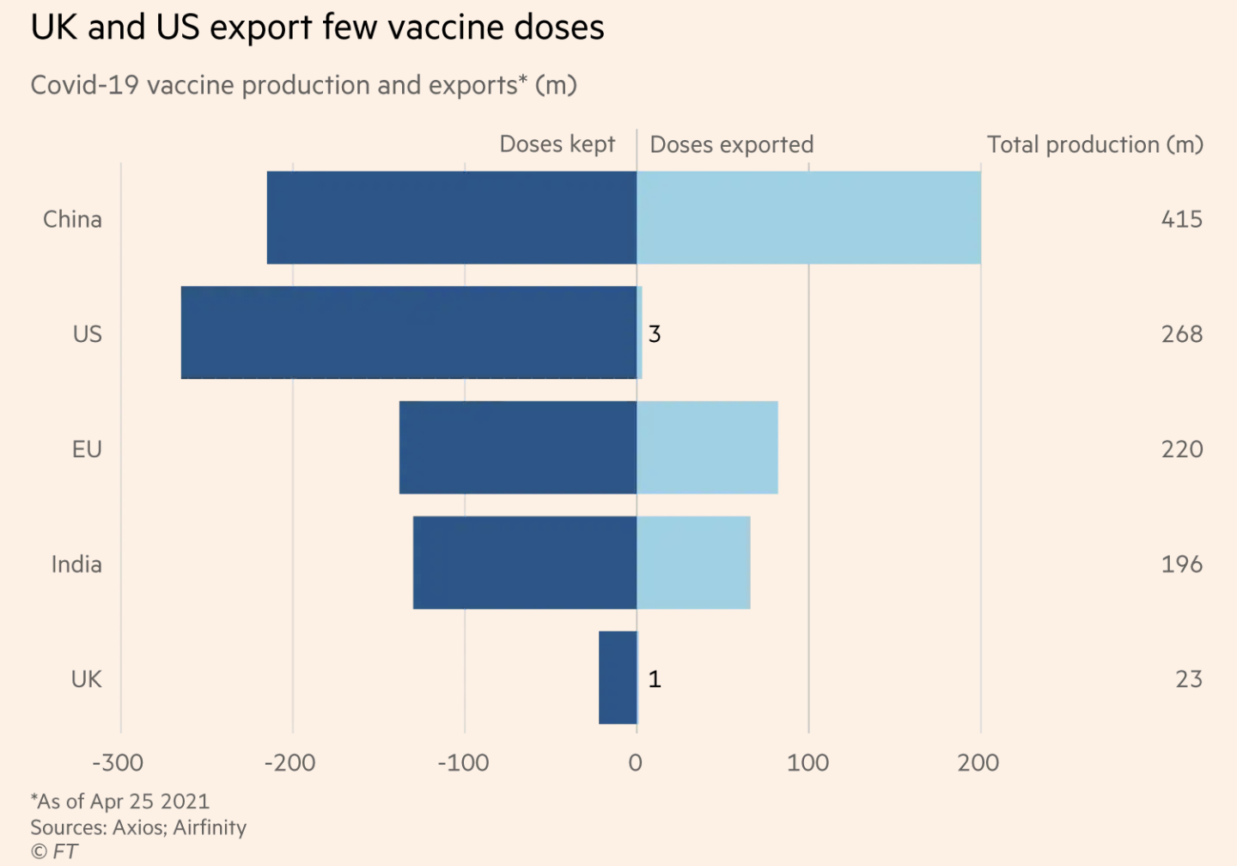
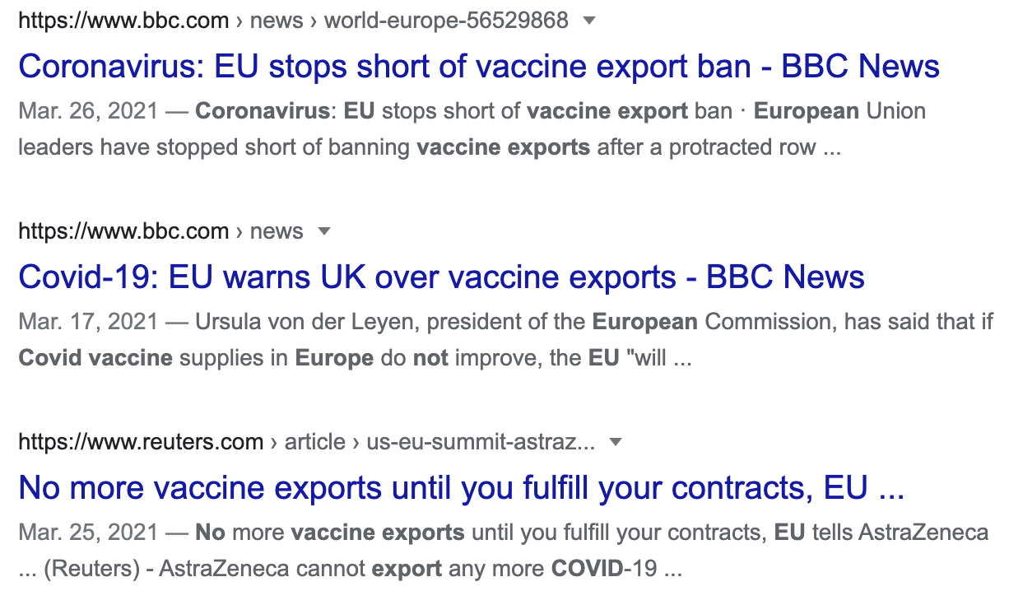
Why can’t we all get the vaccines?
These countries used to strictly control exportation of the vaccines for protecting their national economy.

Slide 4
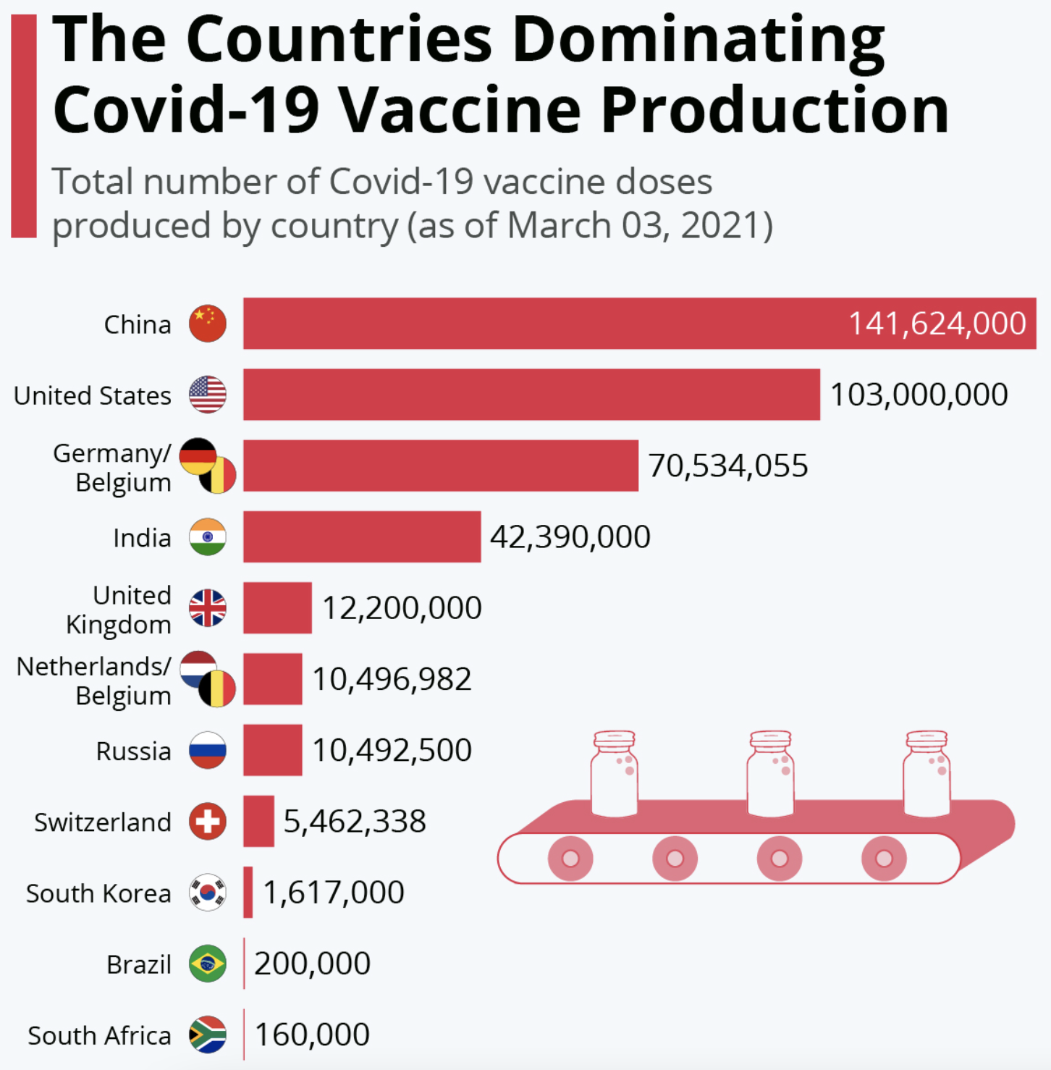

When will COVID-19 end?
Approach:
COVID-19 will end when the top vaccine producing countries no longer have new cases of COVID-19,
so they can provide the vaccines to the world.
Method:
Time Series Analysis
predicting when number of new cases of COVID-19 reaches zero

Slide 5
Dataset
Daily global COVID-19 related data from Our World in Data
Variable | Data Type | Definition
Location | Character | Country’s name
Date | Date | Date
New_cases | Numerical | Number of confirmed cases of COVID-19 in a given date

Slide 6
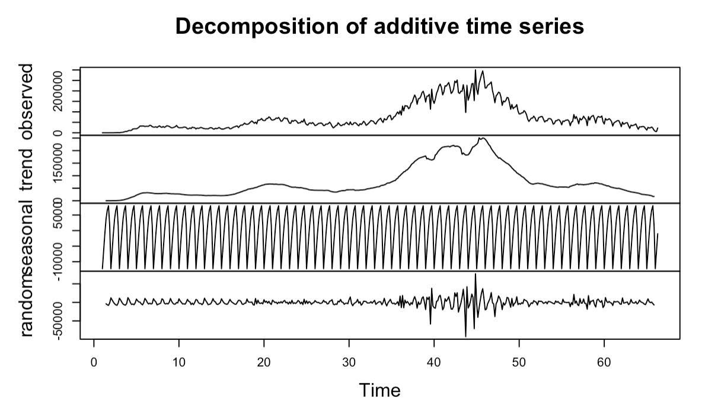
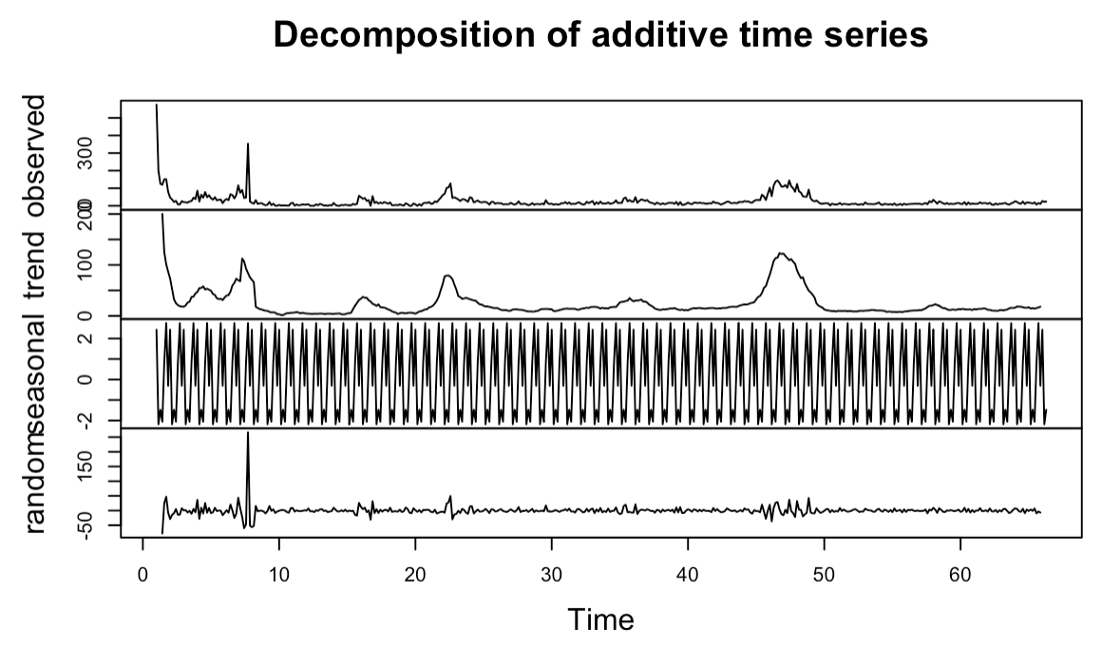
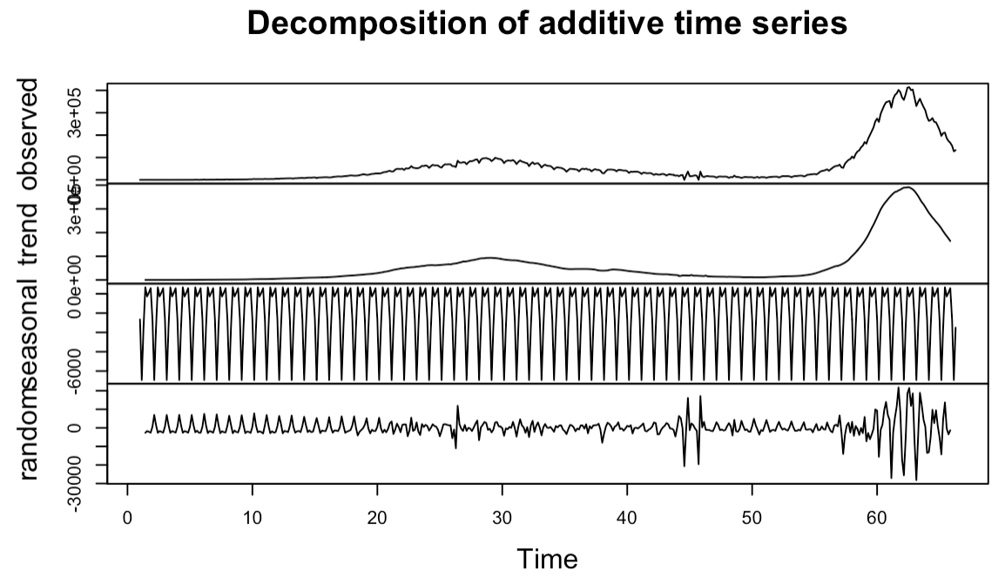
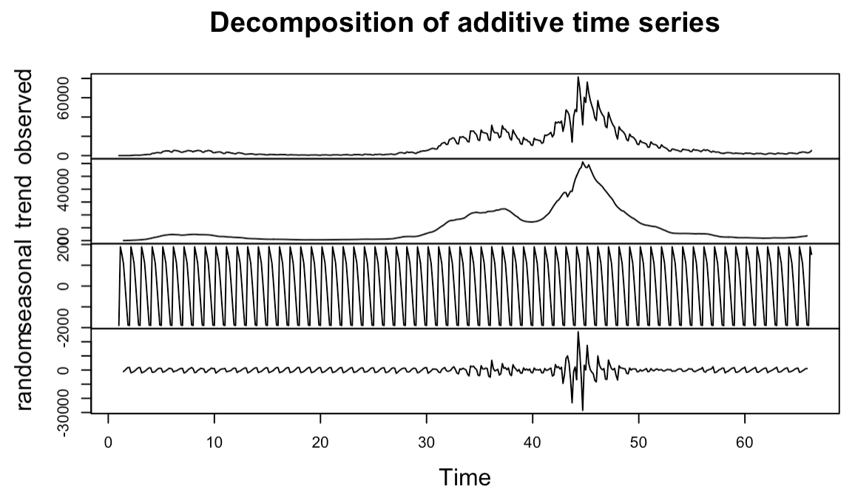
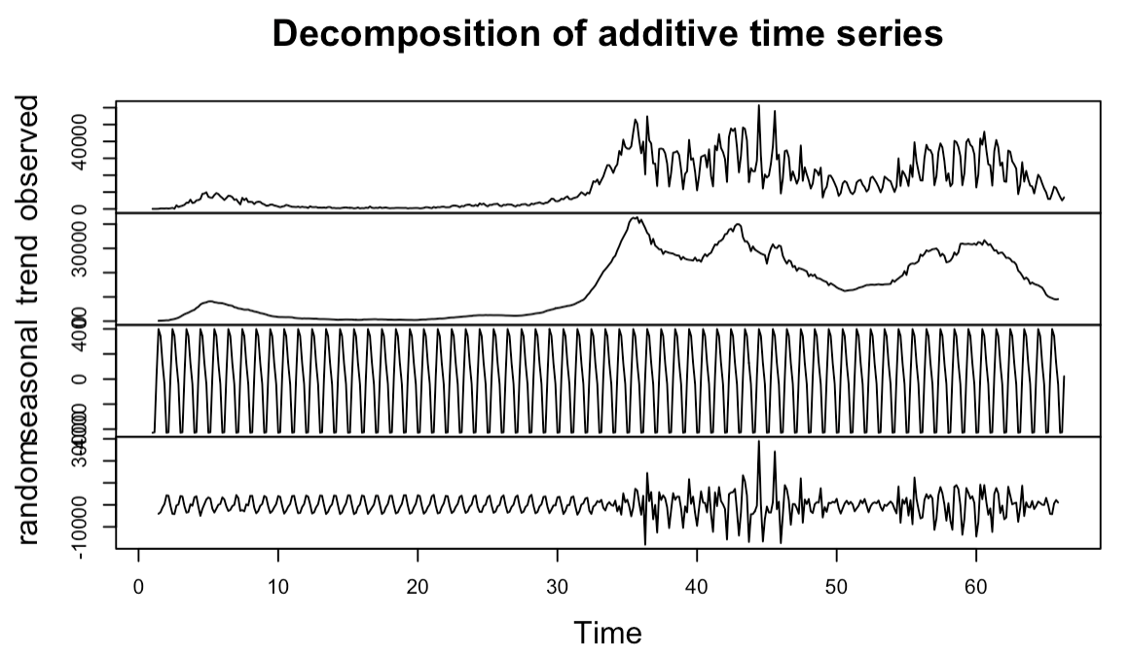
EDA – Decomposition Check
Fig 1. Decomposition plot for US
Fig 2. Decomposition plot for China
Fig 3. Decomposition plot for India
Fig 4. Decomposition plot for UK
Fig 5. Decomposition plot for EU

Slide 7
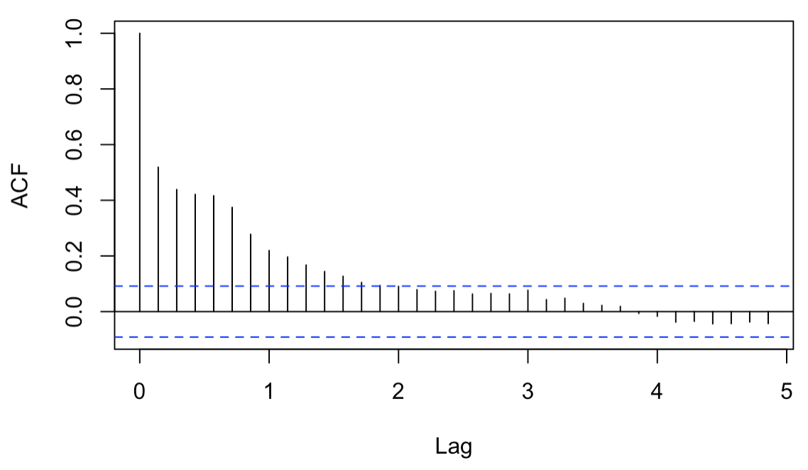
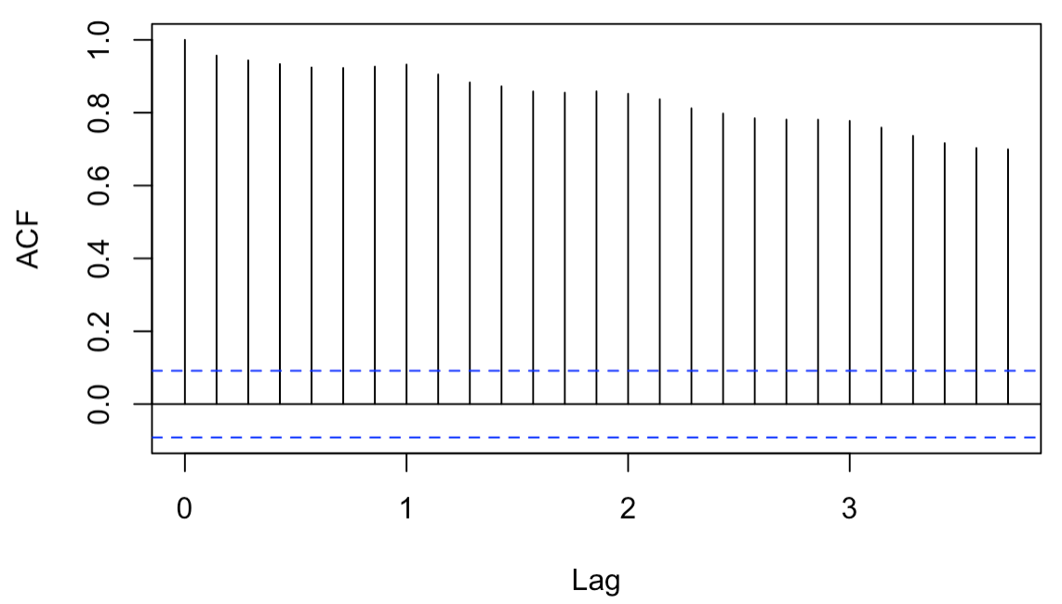
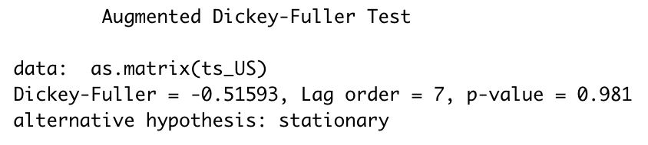
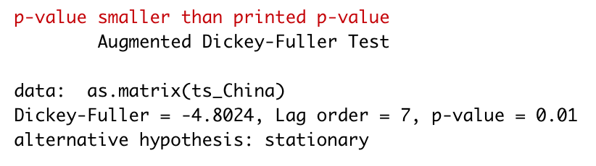
EDA – Stationary Check
Fig 6. Stationary check for US using acf function
Fig 7. Stationary check for China using acf function
Fig 8. Stationary check for US using Augmented Dickey-Fuller Test
Fig 9. Stationary check for US using Augmented Dickey-Fuller Test

Slide 8

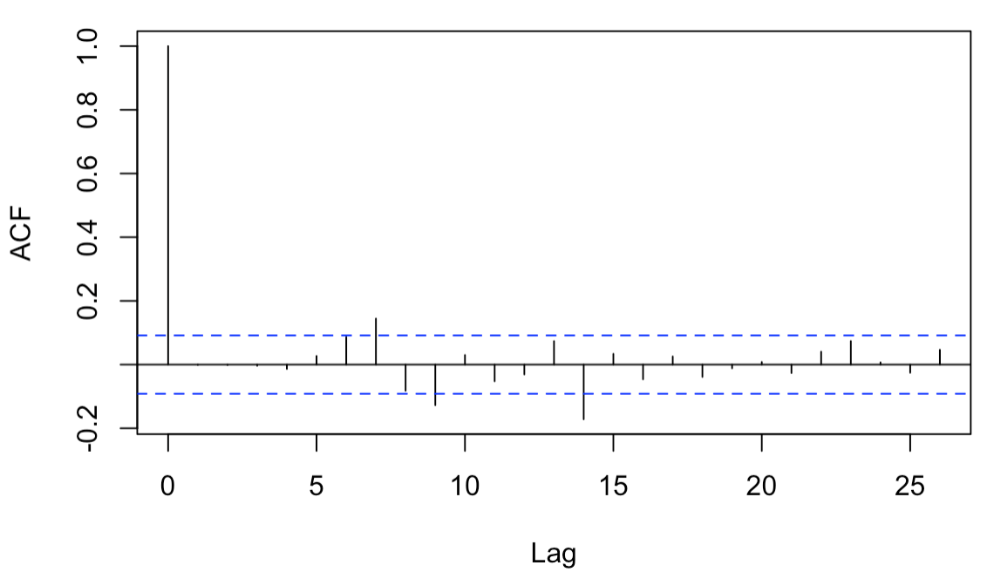
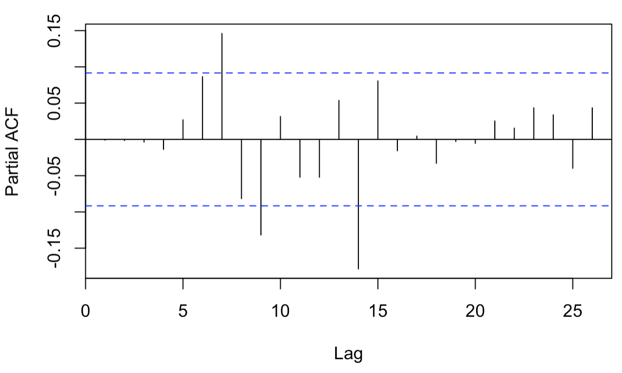
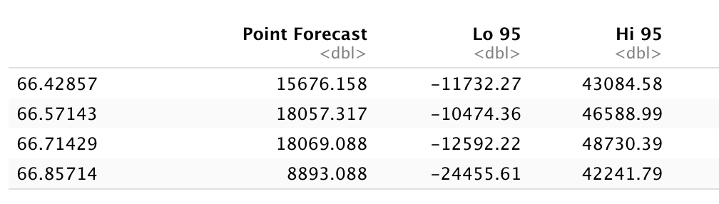
Forecast using Auto ARIMA (US)
Fig 10. result of auto ARIMA for US
Fig 11. acf of US after Auto ARIMA
Fig 12. pacf of US after Auto ARIMA
Fig 13. Forecast of 1 month ahead (4 periods of weekly frequency) for US

Slide 9
Comparison of different ARIMA models (US)
 | Actual Value | Predicted Value | Difference | % in Difference | MAPE | RMSE | Selected model
US (training set of 2020/03 – 2021/06), frequency = 7 | 14,463 | 8,893.08 | 5,569.91 | 39% | 42.17 | 5,263.46
US (training set of 2021/01 – 2021/06), frequency = 7 | 14,463 | 4,236.65 | 10,226.35 | 71% | 42.90 | 5,321.23
US (training set of 2020/03 – 2021/06), frequency = 12 | 14,463 | 19,618.77 | 5,155.77 | 36% | 35.65 | 5,155.77
US (training set of 2021/01 – 2021/06), frequency = 12 | 14,463 | 19,318.81 | 4,855.81 | 34% | 33.57 | 4,855.80 | ✓

Slide 10
 | Actual Value | Predicted Value | Difference | % in Difference | MAPE | RMSE | Selected model
US (training set of 2020/03 – 2021/06), frequency = 7 | 14,463 | 8,893.08 | 5,569.91 | 39% | 42.17 | 5,263.46
US (training set of 2021/01 – 2021/06), frequency = 7 | 14,463 | 4,236.65 | 10,226.35 | 71% | 42.90 | 5,321.23
US (training set of 2020/03 – 2021/06), frequency = 12 | 14,463 | 19,618.77 | 5,155.77 | 36% | 35.65 | 5,155.77
US (training set of 2021/01 – 2021/06), frequency = 12 | 14,463 | 19,318.81 | 4,855.81 | 34% | 33.57 | 4,855.80 | ✓
 | Actual Value | Predicted Value | Difference | % in Difference | MAPE | RMSE | Selected model
EU (training set of 2020/03 – 2021/06), frequency = 7 | 2,337 | 7,650.10 | 5,313.10 | 227% | 293.51 | 7,342.32
EU (training set of 2021/01 – 2021/06), frequency = 7 | 2,337 | 5,705.73 | 3,367.73 | 144% | 254.48 | 6,719.08 | ✓
EU (training set of 2020/03 – 2021/06), frequency = 12 | 2,337 | 10,339.34 | 8,002.34 | 342% | 342.42 | 8,002.34
EU (training set of 2021/01 – 2021/06), frequency = 12 | 2,337 | 12,023.28 | 9,686.28 | 414% | 414.47 | 9,686.28
 | Actual Value | Predicted Value | Difference | % in Difference | MAPE | RMSE | Selected model
UK (training set of 2020/03 – 2021/06), frequency = 7 | 28,071 | 3,944.24 | 24,126.76 | 86% | 63.49 | 13,806.76
UK (training set of 2021/01 – 2021/06), frequency = 7 | 28,071 | 4,175.98 | 23,895.02 | 85% | 61.48 | 13,663.83 | ✓
UK (training set of 2020/03 – 2021/06), frequency = 12 | 28,071 | 4,599.55 | 23,471.45 | 84% | 83.61 | 23,471.45
UK (training set of 2021/01 – 2021/06), frequency = 12 | 28,071 | 4,283.79 | 23,787.21 | 85% | 84.74 | 23,787.21
 | Actual Value | Predicted Value | Difference | % in Difference | MAPE | RMSE | Selected model
China (training set of 2020/03 – 2021/06), frequency = 7 | 18 | 29.76 | 11.76 | 65% | 75.13 | 10.94
China (training set of 2021/01 – 2021/06), frequency = 7 | 18 | 29.7 | 11.70 | 65% | 69.78 | 10.85
China (training set of 2020/03 – 2021/06), frequency = 12 | 18 | 23.33 | 5.33 | 30% | 29.59 | 5.3263
China (training set of 2021/01 – 2021/06), frequency = 12 | 18 | 19.86 | 1.86 | 10% | 10.35 | 1.86 | ✓
 | Actual Value | Predicted Value | Difference | % in Difference | MAPE | RMSE | Selected model
India (training set of 2020/03 – 2021/06), frequency = 7 | 46,617 | 98,886.52 | 52,269.52 | 112% | 91.39 | 52,880.40
India (training set of 2021/01 – 2021/06), frequency = 7 | 46,617 | 91,799.52 | 45,182.52 | 97% | 82.69 | 48,218.16 | ✓
India (training set of 2020/03 – 2021/06), frequency = 12 | 46,617 | 143,780 | 97,163 | 208% | 208.43 | 97,163.18
India (training set of 2021/01 – 2021/06), frequency = 12 | 46,617 | 118,705 | 72,088 | 155% | 154.64 | 72,088.03

Slide 11
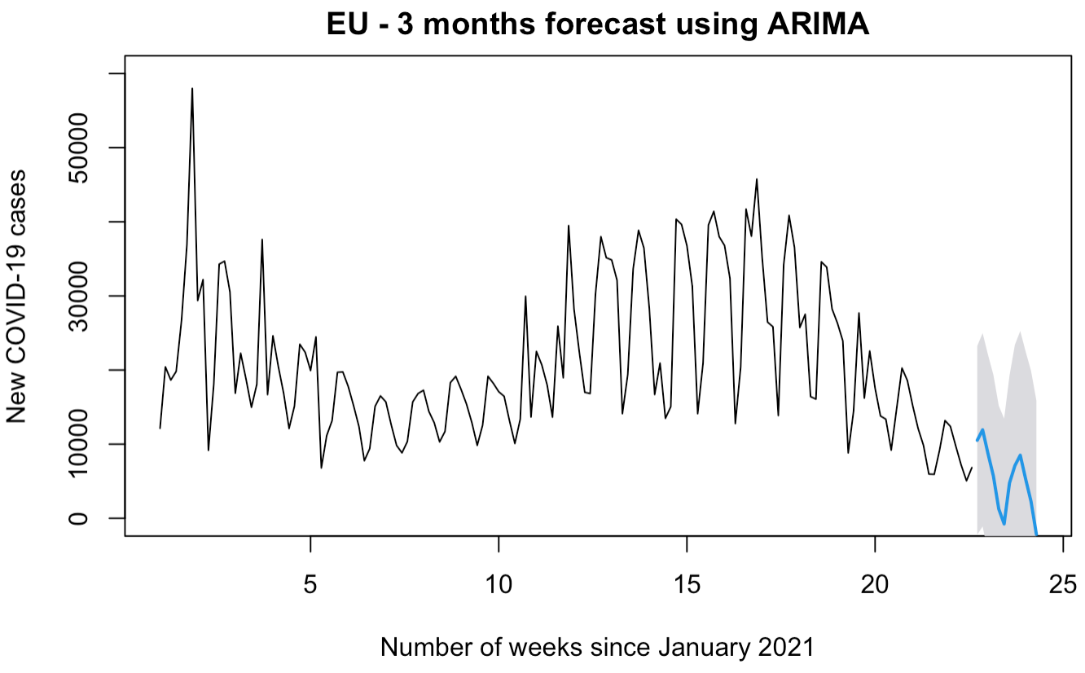
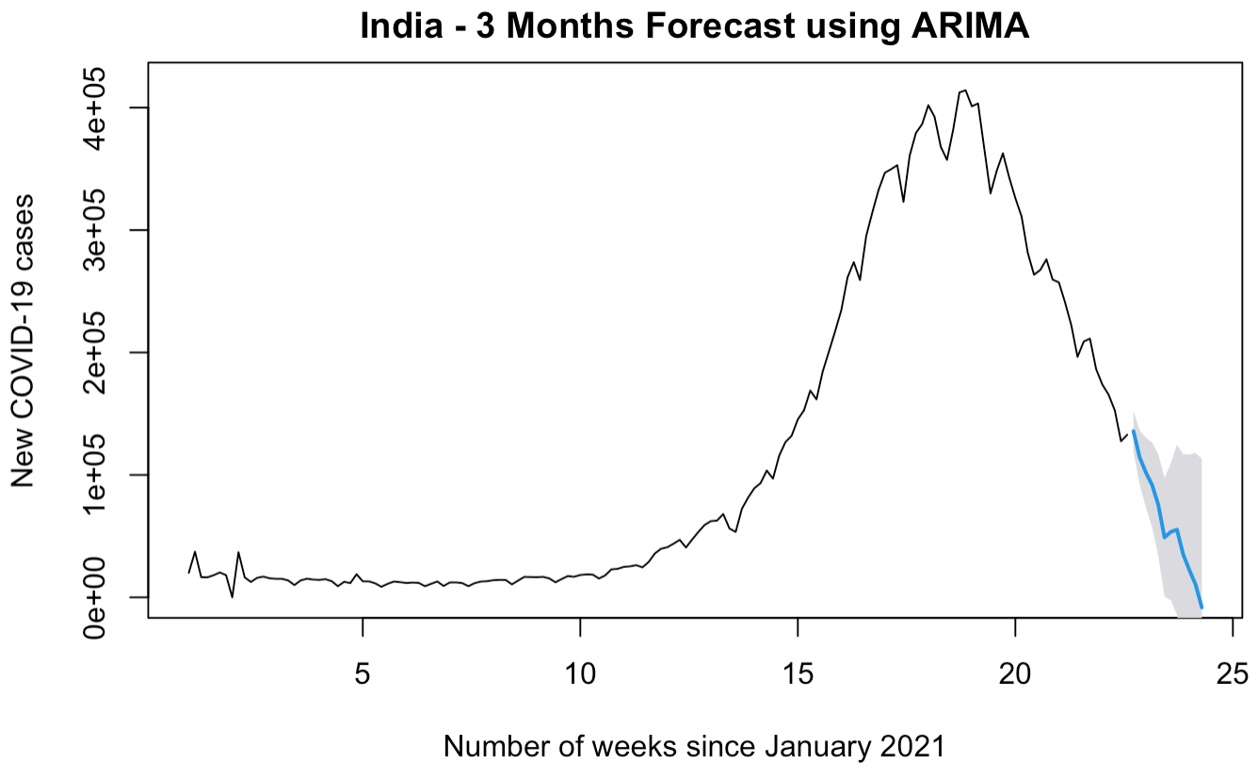
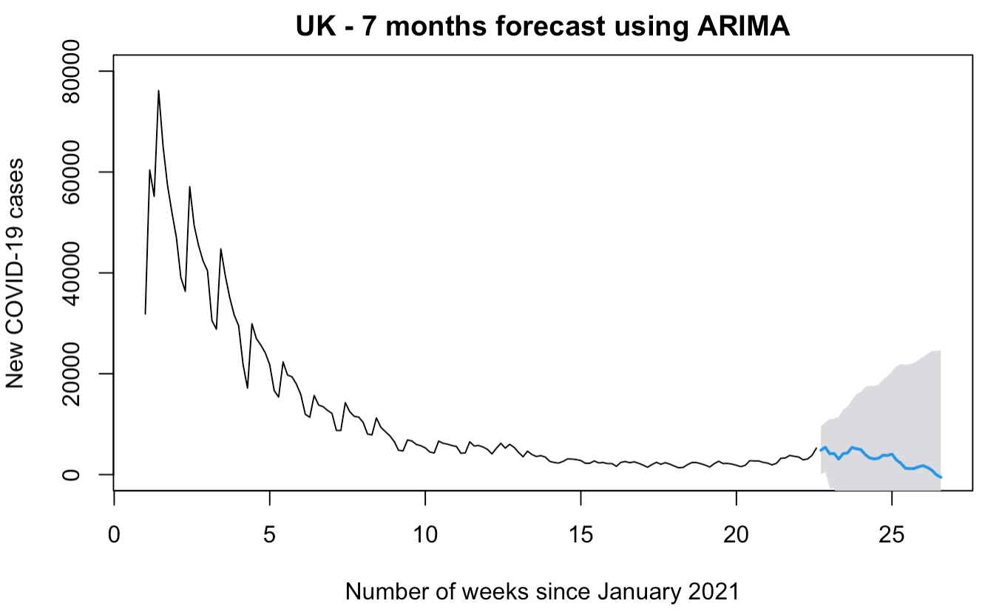
Result
Fig 14. Forecast plot for EU
Fig 15. Forecast plot for India
Fig 16. Forecast plot for UK

Slide 12
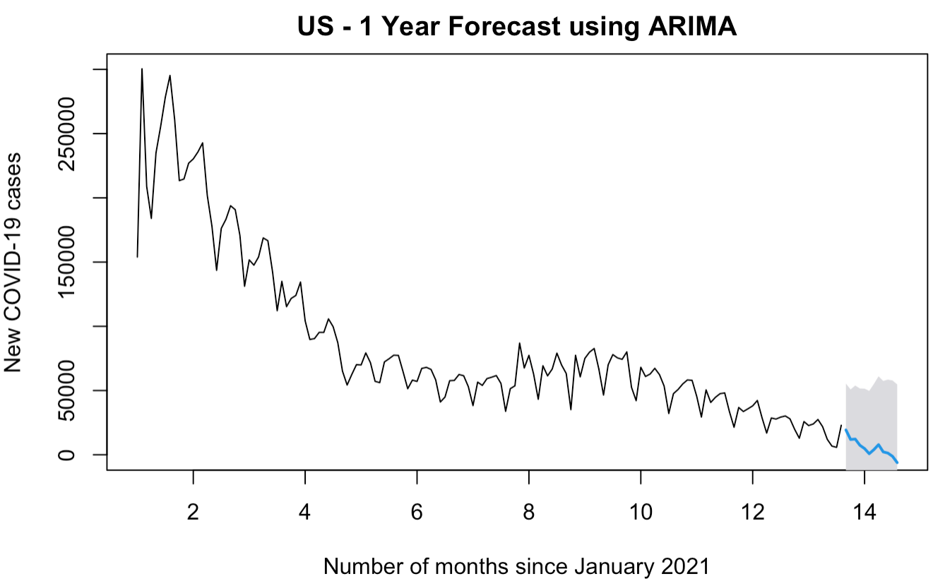
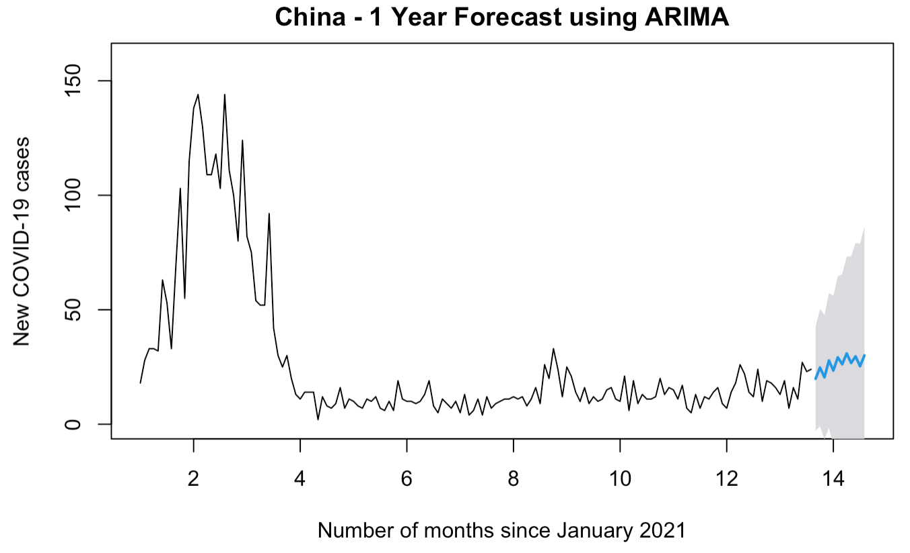
Result
Fig 17. Forecast plot for US
Fig 18. Forecast plot for China

Slide 13
Conclusion
Country | Predicted Value for August 1 | Predicted Value for September 1 | Predicted Value for October 1 | Estimated End Date
US | 11,899 | 12,195 | 7,370 | May 2022
China | 25 | 20 | 28 | unknown
India | 55,310 | 0 | 0 | September 2021
UK | 5,381 | 3,295 | 3,800 | January 2022
EU | 7,096 | 0 | 0 | September 2021
Our time series models predict that the COVID-19 trend in US, India, UK and EU will end in one year, three months, six months, and three months, respectively. The recent numbers of new cases in China was increasing, so the model does not forecast that the new case in China reaches zero.

Slide 14
Prediction for August 1st
Country | Predicted Value for August 1 | Actual Value for August 1 | Difference | % in Difference
US | 11,899 | 25,141 | 13,242 | 111%
China | 25 | 96 | 71 | 284%
India | 55,310 | 40,134 | 15,176 | 27%
UK | 5,381 | 24,470 | 19,089 | 355%
EU | 7,096 | 3,939 | 3,157 | 44%

Slide 15
Limitations
In the past three months, live COVID-19 related predictions were proposed for five vaccine producing countries.
The pandemic may not end this year or next year as our models forecasted, due to the Delta variant.
Our proposed time series models are selected, among various combinations, based on good levels of performance and uncertainty. The results should be more accurate if the COVID-19 trend was the same or similar as three months ago.

Slide 16
How to improve & thoughts
Our models are still useful.
In order to improve, our models should keep track of new COVID-19 trend and accumulate more recent data.
It will eventually forecast the end of the pandemic, again, when new vaccines come out.

Slide 17
Thank you for your attention. Are there any questions? I would love to answer them.

Slide 18
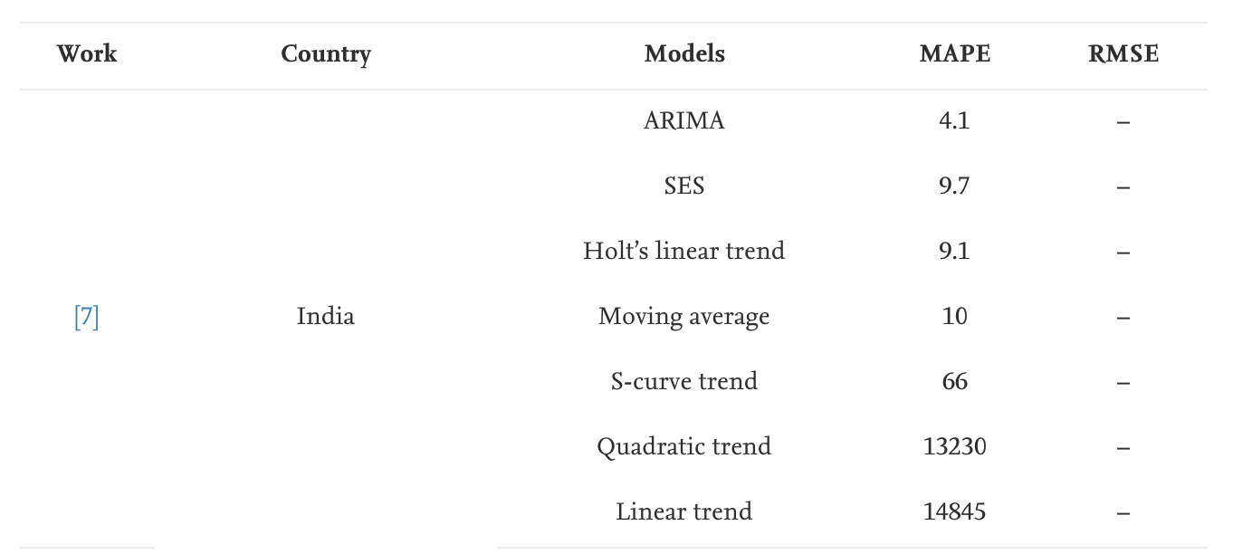
Why ARIMA?
Ismail, L., Materwala, H., Znati, T., Turaev, S., & Khan, M. A. (2020). Tailoring time series models for forecasting coronavirus spread: Case studies of 187 countries. Computational and Structural Biotechnology Journal, 18, 2972–3206. https://www.sciencedirect.com/science/article/pii/S2001037020303998

